Slide 1
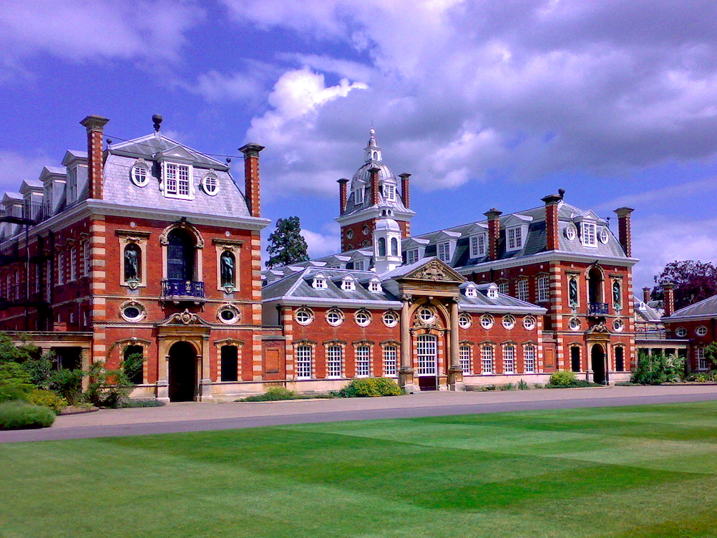
Unit 1
School life
in the UK

Slide 2





Title prediction
When we come to the title School life in the UK, what do you expect to read in this passage?
subjects
teachers
…
school life
classmates
homework

Slide 3
√
□teachers □ students
□ subjects □ class size
□ homework □ grades
□ festivals □ timetable
□ activities □ host family
□ school campus □ school lunch
□ class rules □ class discussion
□ school clubs
√
√
√
√
√
√
√
√
√
√

Slide 4
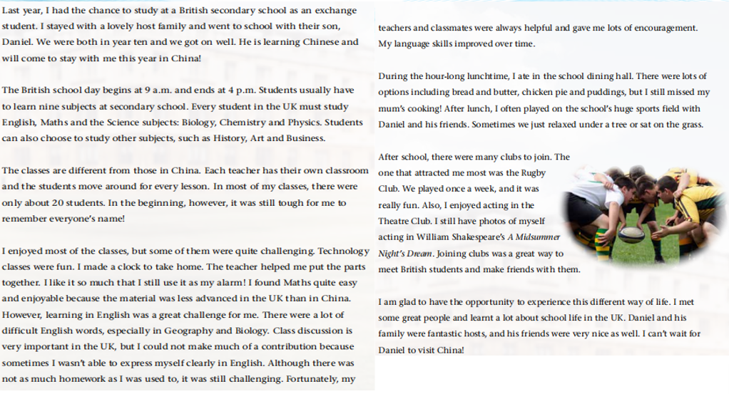
Introduction
Read the passage and learn the structure of the article.
Detailed information
Conclusion

Slide 5
Detailed reading
Read and find out the main information of Part 1 and fill in the blanks.
Part 1
____ _______for studying in the UK:
I had __________to study at a British secondary school as_______________
Para1：
The reason
the chance
an exchange student

Slide 6
Read and find out the main information of Part 2 (Paras 2-6) and fill in the blanks.
Timetable and subjects
Para. 2 ____________:The British school day commonly begins around 9 am.and ends around 4pm.Students usually learn many subjects.
Para.3 ________: The classes are quite _____ ______those in China.
Para.4:_________________ :I enjoyed most of the classes but some were quite__________.
Para.5___________:There were a lot of options.
Para.6 British school clubs: Joining clubs was a great way to ______________________________ .
Class size
different from
午后暖暖的阳光洒在桌上，餐具闪闪发光，有樱桃的小蛋糕显得愈发可口。午后暖暖的阳光洒在桌上，餐具闪闪发光，有樱桃的小蛋糕显得愈发可口。
Learning experiences
午后暖暖的阳光洒在桌上，餐具闪闪发光，有樱桃的小蛋糕显得愈发可口。午后暖暖的阳光洒在桌上，餐具闪闪发光，有樱桃的小蛋糕显得愈发可口。
challenging
School lunch
meet British students and make friends

Slide 7
Read and find out the main information of Part 3 and fill in the blanks.
Part 3
午后暖暖的阳光洒在桌上，餐具闪闪发光，有樱桃的小蛋糕显得愈发可口。午后暖暖的阳光洒在桌上，餐具闪闪发光，有樱桃的小蛋糕显得愈发可口。
Para.7_________:I am glad to have the__________to experience this different way of life and __________ Daniel to visit China.
Feelings
opportunity
can't wait for
午后暖暖的阳光洒在桌上，餐具闪闪发光，有樱桃的小蛋糕显得愈发可口。午后暖暖的阳光洒在桌上，餐具闪闪发光，有樱桃的小蛋糕显得愈发可口。

Slide 8

Comparison
the UK
China
vs
Timetable
Timetable
Subjects
Subjects
9:00–16:00
6:40–22:00
Classes
English Maths
Biology Physics
Chemistry History Art
Geography
Homework
Business
Technology
Chinese
Politics
School lunch
Clubs

Slide 9
Comparison
UK
vs
China
Students moving around
Teachers
______________ moving around
About ________
students per class
About 20
students per class
30–60
Classes
Classes
Class discussion: very important
Class discussion: _____________
optional
More
Homework
Less
Homework
lots of options, including bread and butter, chicken pie and puddings
School lunch
School lunch
?
gymnastics club, basketball club, badminton club...
Clubs
Clubs
Many, including the Rugby Club and the Theatre Club

Slide 10
Understanding the text
What is the type of the article, a narration, an argumentation, or an exposition?
When
Who
Where
What
How
A narration is a story or account of events.
An exposition is a detailed explanation of an idea or a theory.
An argumentation is a discussion in which you make a point and then provide persuasive and logical evidence to back it up.

Slide 11
Genre
What
John Li, a former exchange student
Who
School life in the UK
a British secondary school
Where
When
a year ago
How
glad

Slide 12
Summary
Summarize the main idea of the article with about 50 words.
Requirements
Include those 5 elements in your summary.
Who
When
What
Where
How

Slide 13
A sample
Who
When
What
Where
How
John Li, who studied at a British secondary school as an exchange student a year ago, introduces to us different aspects of the school life in the UK, including timetable, subjects, classes and so on. He also talks about the challenges he faced and feels glad to experience the life.

Slide 14
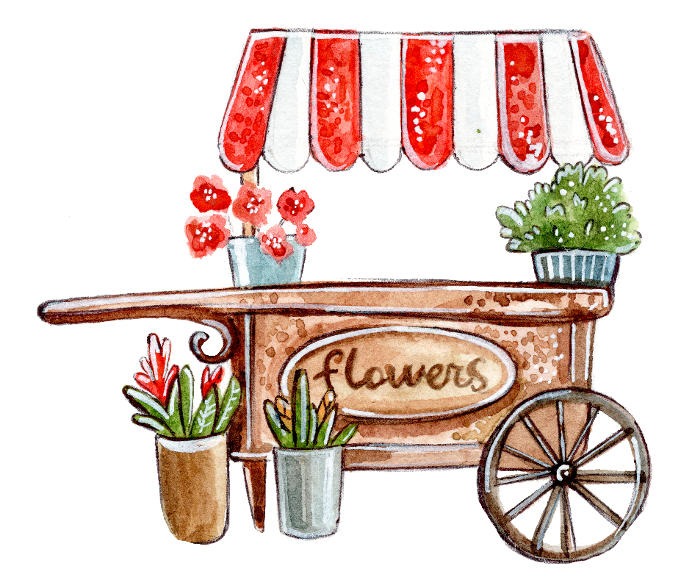
Language Points

Slide 15
Para. 1
Last year, I had the chance to study at a British secondary school as an exchange student. I stayed with a lovely host family and went to school with their son, Daniel. We were both in year ten and we got on well. He is learning Chinese and will come to stay with me this year in China!
有机会做...
adj.中学的
v.交换
n.主人，东道主
相处融洽

Slide 16
1. secondary adj.
中学的；次要的
中学（英国）a secondary school
中学教师 secondary teachers
中学教育 secondary education
【拓展】be secondary to 次要的；不如...重要
翻译：过劳只是导致他生病的一个次要因素。
Overwork is secondary to other causes of his disease.

Slide 17
2. exchange
n. 交换，交易
make an exchange 做交易
in exchange for 换得……
an exchange of glances 互换眼色
v. 交换，调换
exchange A for B 用A去换B
exchange sth. with sb. 与某人交换某物

Slide 18
Practice makes perfect.
exchanged
I shook hands and __________ (exchange) a few words with the manager.
I am going to travel abroad, so I want to exchange some RMB _______ dollars in the bank.
He’s giving her French lessons in exchange _______ her teaching him English.
I went over and exchanged greetings _____ everyone.
for
for
with

Slide 19
3. host
n. 主人；东道主；主持人
a perfect/welcoming host 热情好客的主人
the host nation/city 主办国/主办城市
v.主办；主持
host the World Cup/the Olympics/a TV programme主办世界杯/奥林匹克运动会/主持一档电视节目
【派生词】hostess 女主人；女主持人
-ess表示女性的后缀
女演员
actress
公主
princess

Slide 20
Para. 2
The British school day commonly begins around 9 a.m. and ends around 4 p.m. Every secondary school student in the UK must study English, Maths and the Science subjects: Biology, Chemistry and Physics. In year ten, students usually have to learn nine subjects and they can also choose to study other subjects, such as History, Art and Business.
通常地
生物
化学
物理
adj. Biological 生物学的

Slide 21
Para. 3
be similar to 与...相似
The classes are different from those in China. Each teacher has their own classroom and the students move around for every lesson. In most of my classes, there were only about 20 students. In the beginning, however, it was still tough for me to remember everyone’s name!
与...不同
走来走去
刚开始
adj.艰难的

Slide 22
4. tough
adj. 艰难的；坚硬的；坚强的
a tough game/assignment/journey
in tough times 在艰难的岁月里
as tough as leather 坚韧如皮革
艰难的比赛/任务/旅程
be tough on sb 对某人很严苛
翻译：别对她这么严厉，她只是想帮忙而已
Don’t be too tough on her—she was just trying to help.

Slide 23
Practice makes perfect.
Having to stay indoors all day is tough ___ a kid.
严厉的，无情的
on
The meat is tough.
I want a tough pair of shoes.
She’s a tough customer.
He plays the tough guy in the movie.
Tom is as tough as old boots.
嚼不烂的，老的
坚固的，结实的
难缠的
硬汉
吃苦耐劳的
坚韧不拔；铁石心肠

Slide 24
Para. 4
I enjoyed most of the classes, but some of them were quite challenging. Technology classes were fun. I made a clock to take home. The teacher helped me put the parts together. I like it so much that I still use it as my alarm! I found Maths quite easy and enjoyable because the material was less advanced in the UK than in China. However, learning in English was a great challenge for me. There were a lot of difficult English words, especially in Geography and Biology.
adj.有挑战性的
动词不定式作后置定语
引导结果状语从句
n.闹钟
n.材料
adj.先进的
adv.尤其是
n.地理

Slide 25
5. alarm
n.闹钟;恐慌；警报；警报器
set one's alarm for...
把闹钟设在...
翻译：睡前我把闹钟设在早晨七点
I set my alarm for 7 a.m. before going to bed.
【拓展】
n.恐慌 in alarm 惊慌地 a false alarm 虚惊一场
n.警报器 a fire/smoke alarm 防火/烟雾警报器

Slide 26
5. alarm
v. 使惊恐，使害怕
翻译：妈妈不想让孩子害怕
The mother didn't want to alarm her child.
【派生词】
alarming adj.令人惊慌的
alarmed adj.感到惊慌的
alarmingly adv.
be alarmed at/by 因为...而感到担心、害怕
The Amazon rainforest is disappearing at an alarming speed.
亚马孙热带雨林正以惊人的速度消失。
She was alarmed by the thought of going back home alone.
她一想到要独自一人回家就害怕。

Slide 27
6. material
n.材料；素材
adj. 物质的，实际的；客观存在的
I'm collecting material for an article that I'm writing.
我正在为所写的一篇文章收集素材。
the material world 物质世界
Material wealth never interested her.
物质财富从未引起过她的兴趣。
materialize
v. 实现，成为现实；突然显现，奇怪地出现

Slide 28
Para. 4
Class discussion is very important in the UK, but I could not make a great contribution because sometimes I wasn’t able to express myself clearly in English. Although there was not as much homework as I was used to, it was still challenging. Fortunately, my teachers and classmates were always helpful and gave me lots of encouragement. My language skills improved over time.
做出巨大贡献
和...一样多
习惯于
as much as possible 尽可能多地
adv.幸运地
n.鼓励
久而久之

Slide 29
7. contribution
contribution n. 贡献；捐款；投稿
make contributions to sth. 为……做贡献
contribute v. 捐献；增加；投稿
make a contribution to charity
为慈善做贡献
contribute to sth. 促成某事，是...的原因之一
翻译：这个项目将会促进两个国家之间的交流
The programme will contribute to the cultural exchange between the two countries.

Slide 30
Practice makes perfect.
The school sees its job as preparing students to make a contribution ___ society.
They volunteered ____________(contribute) their own time to the project.
Alcohol ___________(contribute) to 100,000 deaths a year in the US.
Stress is a ___________(contribute) factor in many illnesses.
to
to contribute
contributes
contributing
adj. 贡献的；起作用的

Slide 31
8. be used to
习惯于，适应
to为介词，后面宾语可以是名词、代词、动名词或名词性从句
I’m not used to I have in the canteen.
what
【辨析】
be used to doing sth. 习惯于做某事
be used to do sth. 被用来做某事
used to do sth. 过去常常做某事
I am used to (walk) to school now.
The bus is used to （take）kids to school.
walking
take

Slide 32
9. fortunately
【派生词】
fortune n.运气，机会 fortunate adj.幸运的
unfortunate adj.不幸的 unfortunately adv.遗憾地，不幸地
misfortune n.不幸
I have been fortunate enough (get) the job.
I am fortunate in (have) such good parents.
to get
having
be fortunate to do sth. 运气好可以做某事
be fortunate in... 在......方面很幸运

Slide 33
10. over time
随着时间流逝，久而久之
overtime n.加班
【time相关短语】
at times
at all times
from time to time
in time
at the same time
all the time/the whole time
有时
及时
随时
一直
同时

Slide 34
Para. 5
During the hour-long lunchtime, I ate in the school dining hall. There were lots of options including bread and butter, chicken pie and puddings, but I still missed my mum’s cooking! After lunch, I often played on the school’s huge sports field with Daniel and his friends. Sometimes we just relaxed under a tree or sat on the grass.
选择
黄油面包
生计，主要收入来源
adj. optional 可选择的，随意的
adj.巨大的

Slide 35
11. option
n.可选择的事物，选择
have no option but to do sth. 别无选择只好做...
翻译：我们别无选择，只能等待救援。
the option of doing/to do sth. 做...的选择
翻译：学生可以选择网络课程。
【常用短语】
leave/keep your options open 保留选择余地
the soft/easy option 轻松的选择，捷径
We have no option but to wait for the rescue.
Students have the option to take/of taking online courses.

Slide 36
Para. 6
After school, there were many clubs to join. The one that attracted me most was the Rugby Club. We played once a week, and it was great fun. Also, I enjoyed acting in the Theatre Club. I still have photos of myself acting in William Shakespeare’s A Midsummer Night’s Dream. Joining clubs was a great way to meet British students and make friends with them.
吸引
动词-ing形式的复合结构作宾语

Slide 37
12. attract
attract sb to sb/sth. 引起某人对...的好感
翻译：吸引我的是她的大眼睛。
be attracted by... 被...所吸引
翻译：我被她动听的演唱所吸引。
attractive adj. 有吸引力的
attraction n. 吸引；吸引力；具有吸引力的事物
What attract me to her was her big eyes.
I was attracted by her beautiful singing.
【派生词】

Slide 38
Practice makes perfect.
The Melbourne City Tourist Shuttle is a free bus service, stopping at key tourist (attract) in and around the city.
Actually, the three columns are equally _________ (attract) to us students.
_________(attract) by the beauty of nature, I decided to spend another two days on the farm.
attractions
attractive
Attracted

Slide 39
Para. 7
I am glad to have the opportunity to experience this different way of life. I met some great people and learnt a lot about school life in the UK. Daniel and his family were fantastic hosts, and his friends were very nice as well. I can’t wait for Daniel to visit China!
等不及让...

Slide 40
1.动词不定式作后置定语
动词不定式是一种常见的非谓语动词形式，由“to+动词原形”构成。
当作定语的动词不定式修饰的名词或代词是不定式动作的承受者时，不定式既可以用主动形式，也可以用被动形式，但含义有所不同
I have an article to type. (不定式to type的施动者是句子的主语)
I have an article to be typed. (不定式to be typed的施动者不是句子的主语)

Slide 41
1.动词不定式作后置定语
(1)the frst、the second等序数词，the best等最高级，the only、the last等后面经常跟动词不定式作定语。
She is always the frst to come and the last to leave.
He is the best man to do the job.
(2)动词不定式常修饰的名词有ability、chance、hope、plan、decision、promise等。
He finally made the decision to continue with the project.
She kept her promise to write to me monthly.

Slide 42
Practice makes perfect.
There are still many problems (solve) by scientists before we are ready for a long stay on the moon.
I was watching the clock all through the meeting, as I had a train (catch).
to be solved
to catch

Slide 43
2.so...that...引导结果状语从句
意为“如此...以至于...”，so是副词，后面跟形容词或者副词
形容词/副词
形容词+a(n)+单数可数名词
many/few+可数名词复数
much/little+不可数名词
so+
+that
形容词+不可数名词
形容词+可数名词复数
a(n)+形容词+可数名词复数
such+
+that

Slide 44
2.so...that...引导结果状语从句
so that引导结果状语从句时，置于主句之后，常用逗号隔开。
He missed the bus, so that he was late for school.
so that引导目的状语从句时，置于主句之后，从句中需要用情态动词may，can或will等，一般不用逗号隔开。
He got up early so that he could catch the bus.
so/such...置于句首时，主句要进行部分倒装。
He speak so fast that we couldn’t follow him.
=So fast did he speak that we couldn’t follow him.

Slide 45
Practice makes perfect.
1. She is such a helpful girl that we all like her.
She is a girl that we all like her.
helpful a girl that we all like her.
2. 为了能待在家照顾家庭，凯西在她儿子出生的时候辞职了。
Cathy had quit her job when her son was
born she and raise her family.
so helpful
So
is she
so that
could stay home

